Slide 1

Online food ordering management system
Akshit Agarwal

Slide 2

PROBLEM STATEMENT
To
To Create an Online Food Ordering System that involves multiple tables to store information about menus, orders, customers, food, food category, login/logout and much more.

Slide 3

PHP - It is a server-side scripting language widely employed in web development for creating dynamic content.
CSS - It is used to separating style from structure, CSS facilitates page layout, enabling the responsive arrangement of elements, defining typography characteristics like font, size, and color, and controlling the color scheme and backgrounds for a cohesive design.
SQL - It is indispensable in database management, providing a standardized means to define, create, and manage relational databases.
Languages used

Slide 4
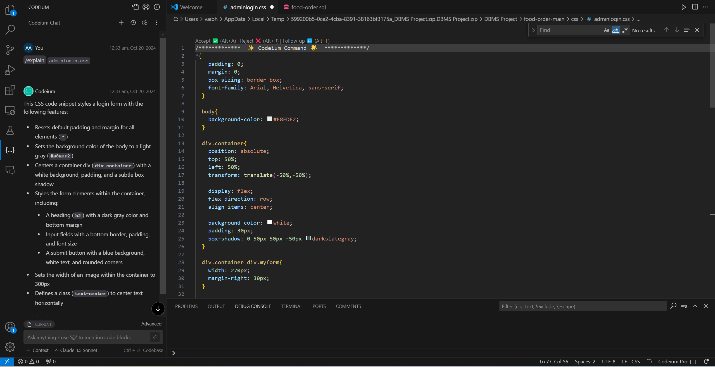
USING CODEIUM

Slide 5
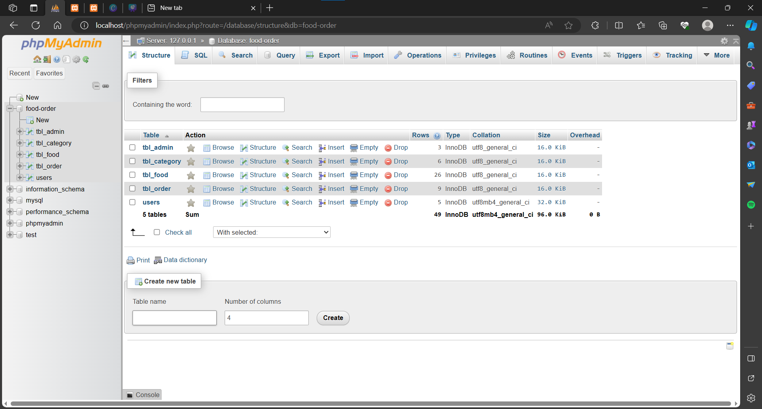
PHPMYADMIN SERVER

Slide 6
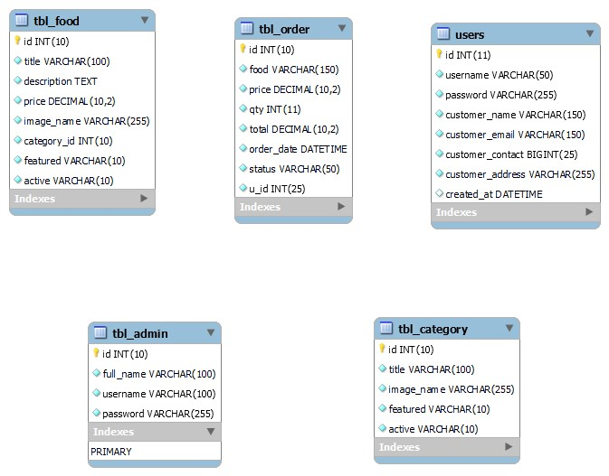
TABLES IN OUR DATABASEJ

Slide 7
KEYS IN OUR DATABASE
In our database schema, the primary key and unique key constraints serve as the primary forms of indexing. Here's a breakdown of the indexes used in each table:
tbl_admin Table:
Primary Key index: id
tbl_category Table:
Primary Key Index: category_id
tbl_food Table:
Primary Key Index: food_id
tbl_order Table:
Primary Key Index: order_id
users Table:
Primary Key Index: user_id
Unique Key Index: username is marked as a unique key, creating an index to enforce uniqueness.
In each case, the primary key index is automatically created when defining the primary key constraint. This index is essential for quickly identifying and accessing specific rows in the table.
Additionally, the unique key index on the username column in the users table ensures that each username is unique, facilitating efficient searches based on usernames.
Also, the foreign key relationships (e.g., category_id in tbl_food and user_id in tbl_order) also contribute to indexing, as they reference primary key columns in other tables.

Slide 8
INDEXES IN OUR DATABASE
We have used B-Tree indexing in our database schema.
In the MySQL databases, the default storage engine is InnoDB, and InnoDB uses a B-tree structure for its indexes, including primary keys and unique keys.
It uses a clustered B-tree structure for the primary key index. This means that the data rows in the table are organized based on the order of the primary key.
For unique keys also, B-Tree structure is used.
B-tree indexes provide efficient search, insertion, and deletion operations, making them well-suited for a wide range of query patterns.

Slide 9
USE OF TRANSACTIONS AND HASHING
1. Transactions:
- The `tbl_order` table includes a `status` column, which represent the status of an order (‘Out for delivery’, ‘Ordered’, ‘Delivered’, ‘Cancelled’). The `tbl_order` table's structure is a scenario where transactions and status changes are relevant.
2. Hashing for Passwords:
- The `tbl_admin` table includes a `password` column, which stores hashed passwords. Passwords should be hashed and salted before storage to enhance security. We used a one-way cryptographic hash function to store passwords securely.
Example of a hashed password:
- INSERT INTO `tbl_admin` (`id`, `full_name`, `username`, `password`) VALUES
(12, 'Administrator', 'admin', '$2y$10$SOME_HASHED_PASSWORD');

Slide 10

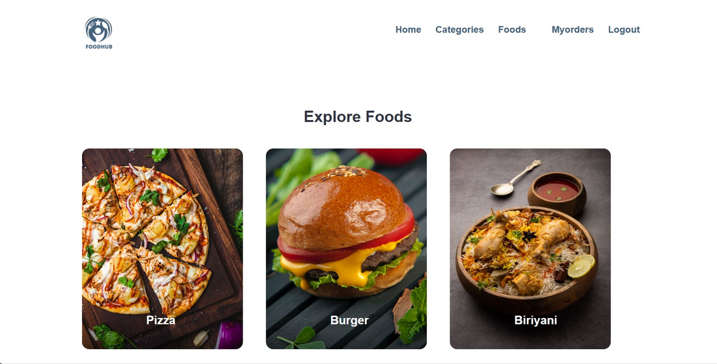
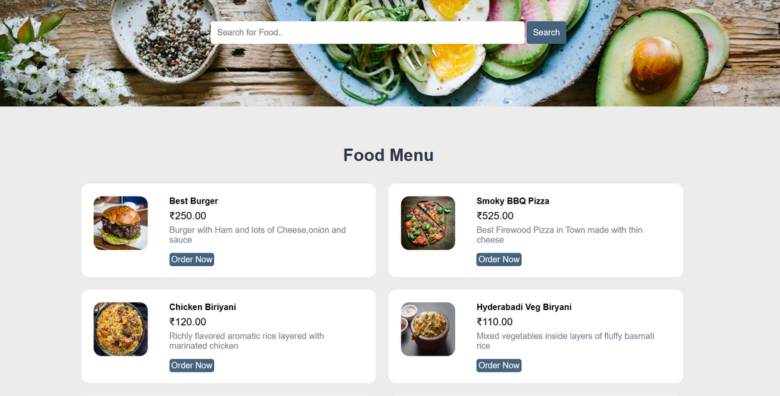
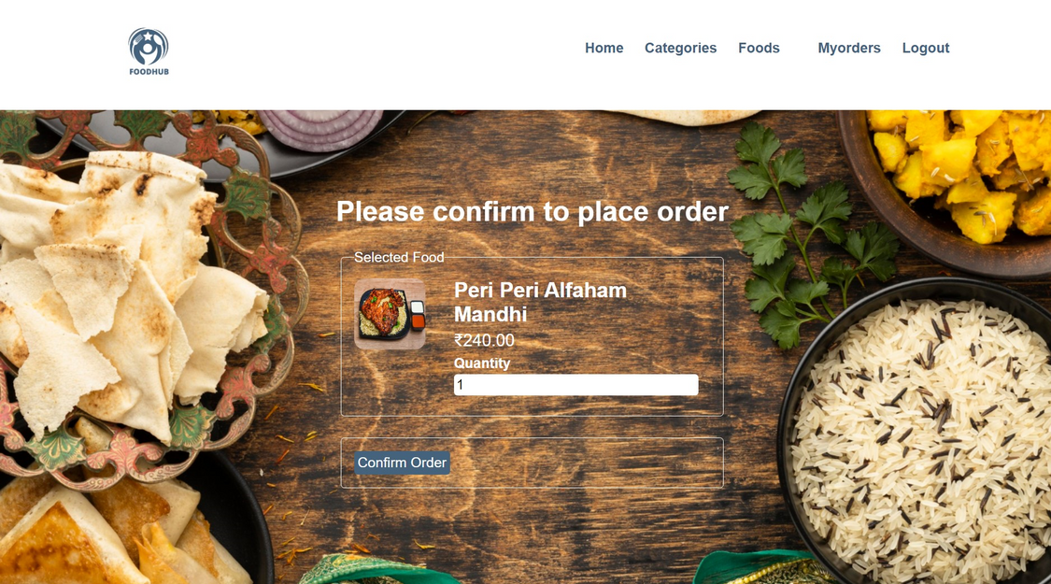
TABS IN USER SECTION

Slide 11
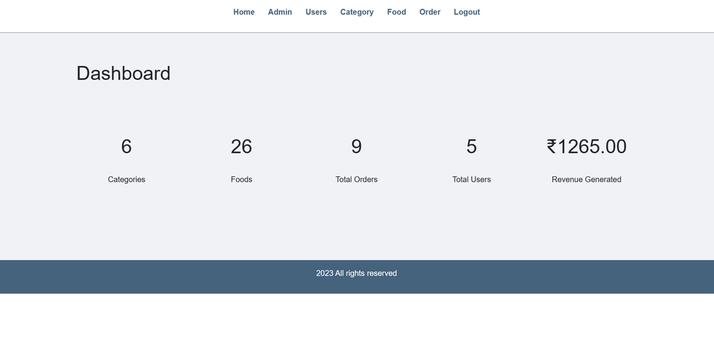
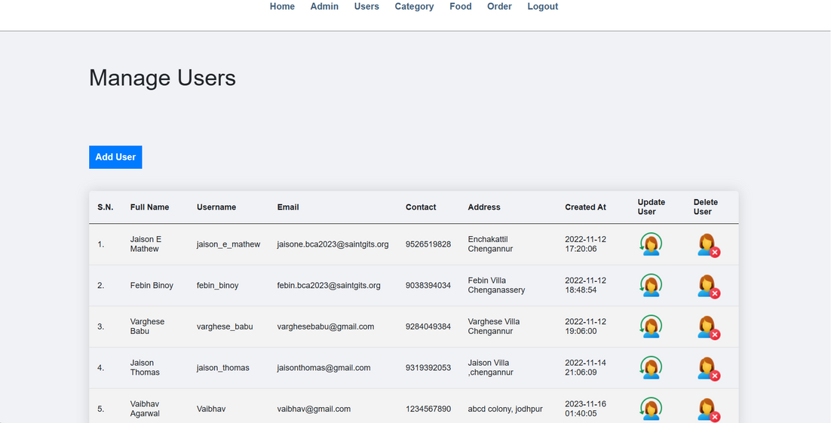
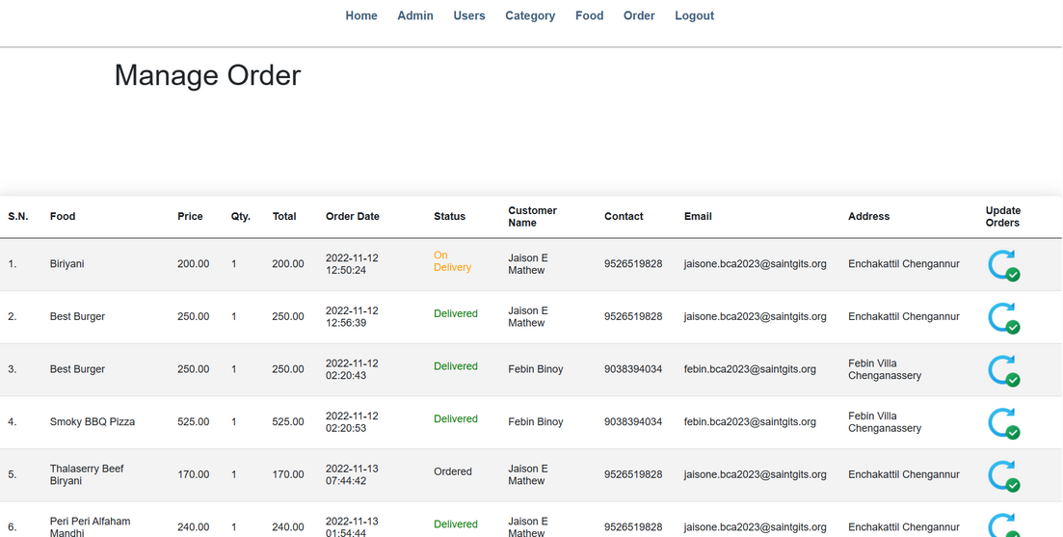
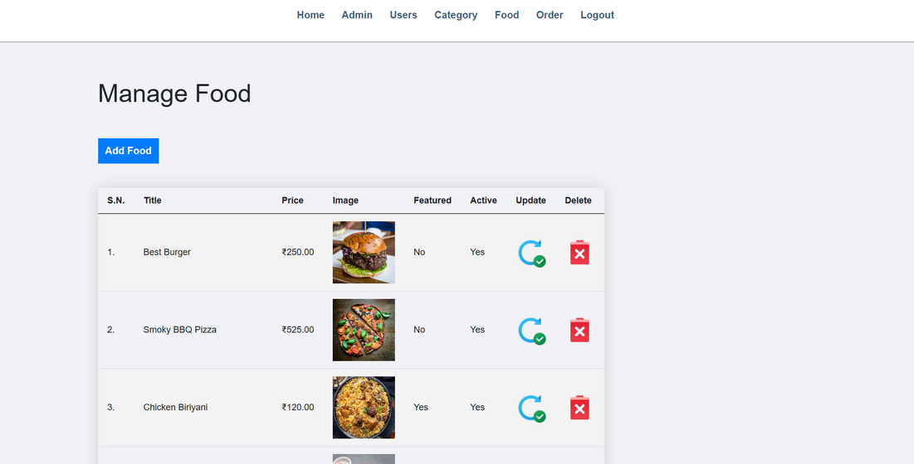
TABS IN ADMIN SECTION

Slide 12


THANK YOU

